Slide 1
Frog Dissection

Slide 2
Path Food travels
Pharynx
Esophagus
Stomach
Small Intestine
Large intestine
Cloaca
*Teeth not used for chewing; just for holding

Slide 3
Path of Blood
Deoxy, Right Atria
Ventricle
Lung (oxygenated)
Left Atria
Ventricle
Body

Slide 4
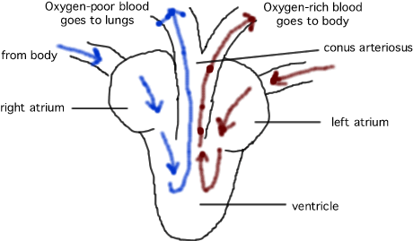

Slide 5
Path of Air
In Nostril
Mouth
Lung
Back out the nostril

Slide 6
Path of Urine
Kidneys
Urinary duct
Urinary bladder
Cloaca

Slide 7
Sperm / Eggs
Testes…sperm duct…cloaca
Ovaries….oviduct….cloaca

Slide 8
Nictitating Membrane
Protect eyes while still seeing
Maybe stop water loss

Slide 9
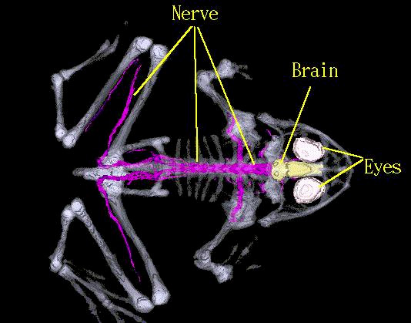

Slide 10
Video #56(frog dissection), 57(Live frog dissection)

